Slide 1
Nuclear Fuel Performance
NE-533
Spring 2023

Slide 2
Last time
Cladding oxidizes, forming ZrO₂
Can determine oxide thickness from weight gain, or from time/temperature
The limiting step for oxidation is the oxygen transport through the oxide layer

Slide 3
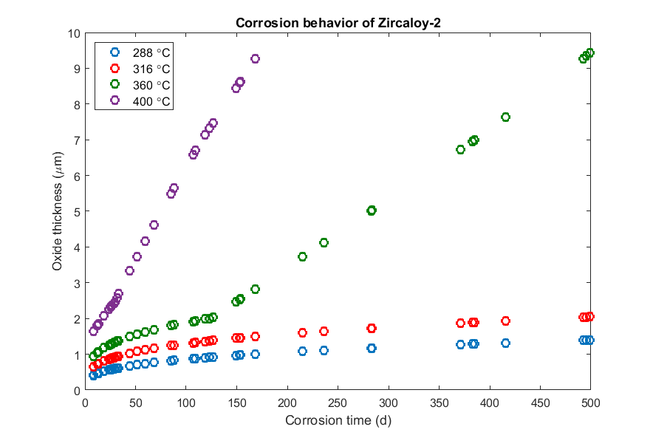
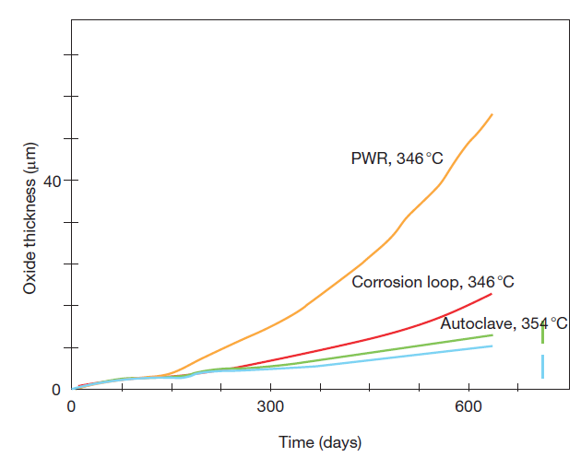
Other factors affecting corrosion
Irradiation: Radiation damage to the metal; Radiation damage to oxide
Temperature:
Corrosion rate increases with temperature

Slide 4
Impact of Corrosion
The oxide layer has a low thermal conductivity, restricting heat transport
For Zircaloy, k = 22 W/(mK)
For ZrO₂, k = 1.7 – 2.7 W/(mK)
The oxide layer is much more brittle than the zircaloy
Zircaloy metal is removed as brittle oxide is added to the material
Oxidation produces hydrogen that can enter the cladding and form brittle hydrides

Slide 5
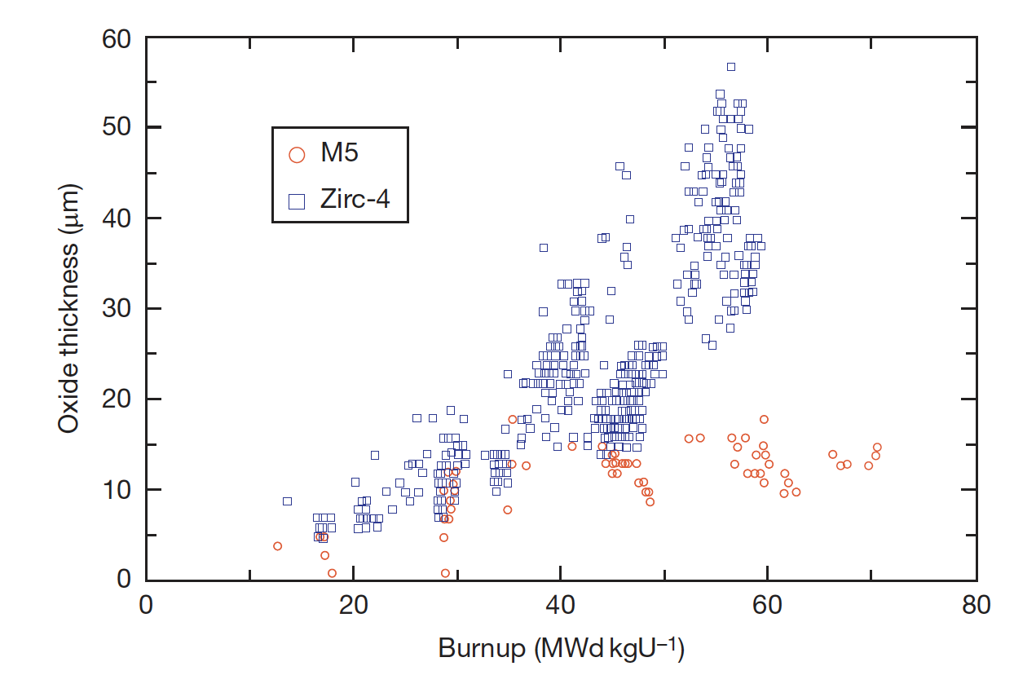
Corrosion Control
The oxidation and hydrogen uptake of Zircaloy is of course determined by many factors
The chemical and physical state of the material: composition, metallurgical condition, and surface condition
Two different zirconium alloys employed in the French PWRs, Zircaloy and Zr1% Nb (M5), display distinct corrosion behaviors
The peak oxide layer thickness of Zircaloy-4 increases significantly with burnup, whereas that of Zr1%Nb shows a moderate increase

Slide 6
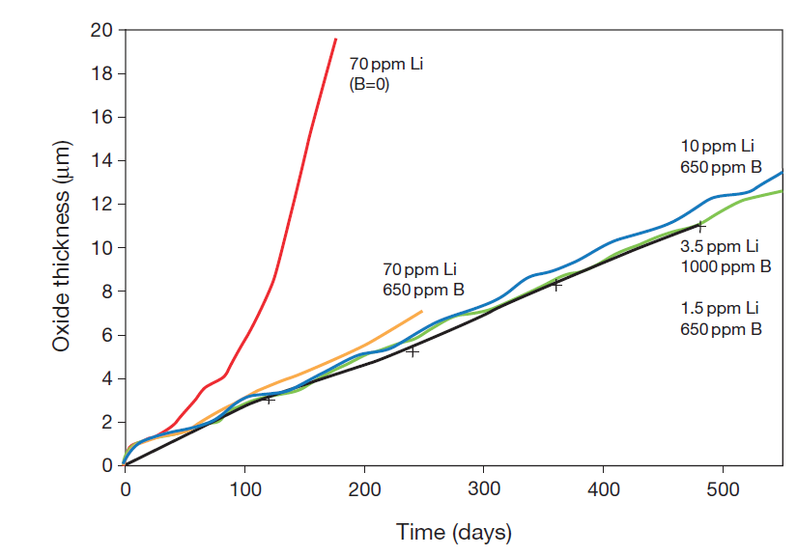
Corrosion Control
Water Chemistry
The dissolved oxygen and hydrogen play a major role in the corrosion process, but other dissolved species must also be taken into account
To control the pH of the coolant at slightly alkaline conditions, LiOH is added and H3BO3 (boric acid) is added for reactivity control in PWRs
Impurities (Cl, F) and coolant-borne species (Cu, Ni, etc.) must be considered
Temperature and irradiation also have an effect on the corrosion behavior, but are governed by engineering constraints
CRUD (Chalk River Unidentified Deposit) can accelerate corrosion

Slide 7
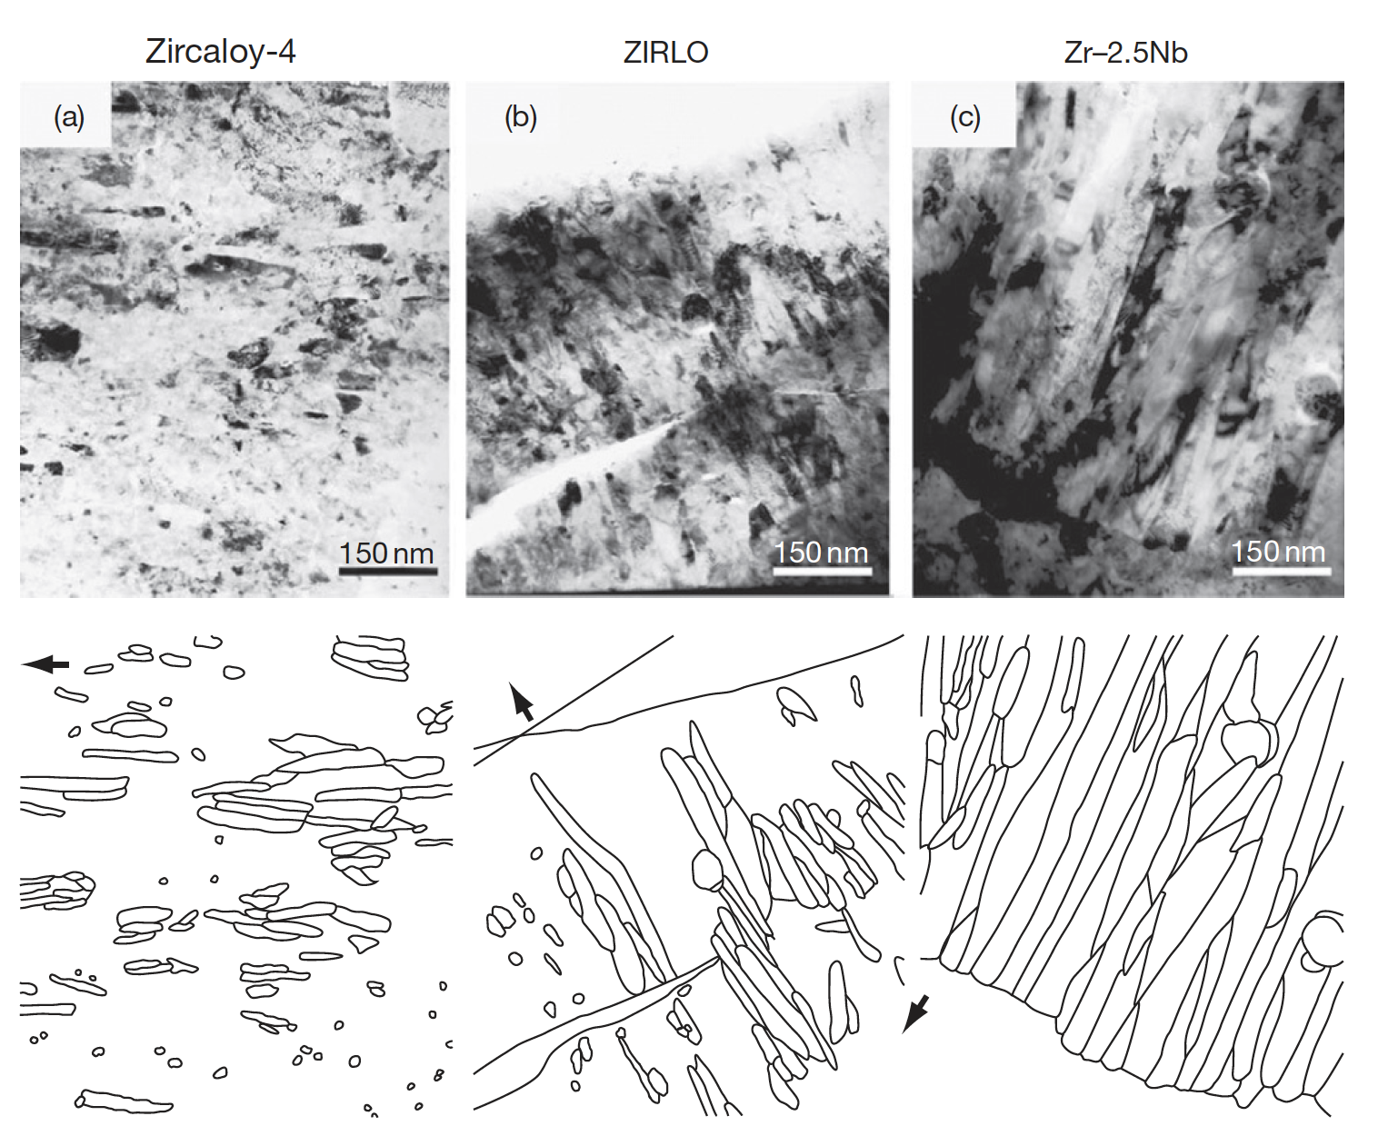
Corrosion Layer
Uniform corrosion is a passivating event since a protective layer of zirconium oxide is formed as a result of the reaction with the O2 ions or the OH radicals
The oxide layer is microcrystalline, initially equiaxed, later growing into columnar grains that are formed in a dense packing, of which the mean crystallite size increases as the oxide thickens

Slide 8
Corrosion Summary
Corrosion is the environmental degradation of materials
Cladding oxidizes, forming ZrO₂
The limiting step for oxidation is the oxygen transport through the oxide layer
It begins being controlled by diffusion
Then, a protective layer forms that slows oxidation
Once transition occurs, it loses its protectiveness and speeds up again
Oxidation hurts cladding performance by
Restricting heat transport
Converting zircaloy into a brittle oxide

Slide 9
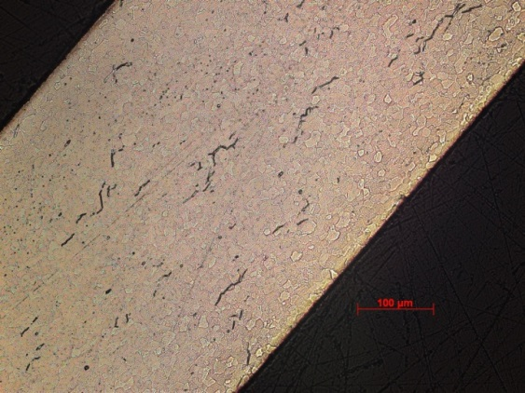
Hydride Formation
Corrosion reaction:
Corrosion of zirconium is so damaging in large part due to hydride formation
Some of the hydrogen atoms produced by oxidation enter the cladding and form a hydride phase
Other sources of H as well can increase the amount available to form hydrides, but this is minor
The fraction of the produced hydrogen that enters the cladding is defined by the pickup fraction:
Hydrogen is produced twice as fast as oxygen
J_{H} = 2 f J_{O}
ZrO₂
Zr metal
Hydrogen pick-up

Slide 10
Given a thickness of oxide, how can we predict the hydrogen pickup?
A cladding with an initial thickness of 600 microns that initially has 40 wt. ppm H undergoes corrosion to a total oxide thickness of 80 microns. What is the overall hydrogen content in wt. ppm if the hydrogen pickup fraction is 15%?
First, we must determine the weight of H that has entered the cladding
ρ_{ZrO2} is 5.68 g/cm³, of which 32/(91+32)= 0.26 = 26% is O, thus 1.47 g/cm³ of O
A 1 micron oxide layer corresponds to a weight gain of 14.7 mg/dm² and thus with an 80 micron layer, weight gain = 14.7*80 = 1176 mg/dm²
This mass corresponds to 1.176 N_{A}/16 atoms of oxygen = 4.42 x 10²² atoms/dm²
f = 15%, so the ingress of hydrogen will be 0.15*2*4.42e22 = 1.33e22 atoms of hydrogen/dm², or 0.022 g of H.
Now, we determine the fraction in wt. ppm in a 10 cm square cross section w/ PBR = 1.56
The uncorroded thickness is 600 – 80/PBR = 600 – 80/1.56=549 microns
The volume of zirconium is 549 x 10⁻⁴ (cm)*10*10 =5.49 cm³
ρ_{Zr} = 6.5 g/cm³, so the total mass of Zr is 6.5*5.49 =35.7 g.
Thus the hydrogen concentration is 0.022/35.7 =6.18e-4= 618 wt. ppm, which, added to the original 40 wt. ppm, is 658 wt. ppm

Slide 11
We can estimate the hydrogen content in the cladding from the oxide thickness δ and the pickup fraction f

Slide 12
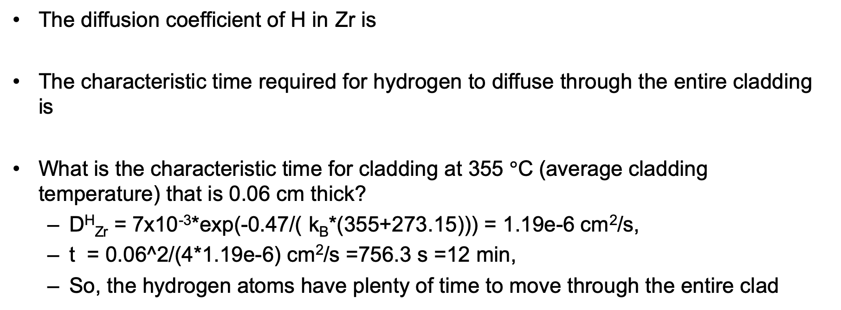
Hydrogen Diffusion
The diffusion coefficient of H in Zr is
The characteristic time required for hydrogen to diffuse through the entire cladding is
What is the characteristic time for cladding at 355 $°$C (average cladding temperature) that is 0.06 cm thick?
D^{H}_{Zr} = 7x10⁻³*exp(-0.47/( k_{B}*(355+273.15))) = 1.19e-6 cm²/s,
t = 0.06^2/(4*1.19e-6) cm²/s =756.3 s =12 min,
So, the hydrogen atoms have plenty of time to move through the entire clad

Slide 13
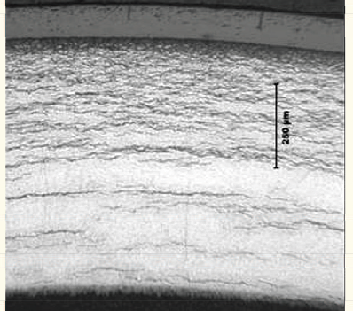
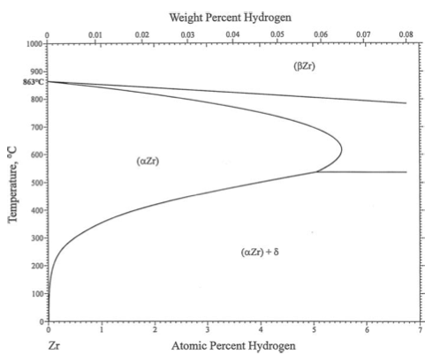
Hydriding
Hydride concentrations are not uniform, because they respond to temperature and stress gradients
Hydrogen tends to move toward lower temperature (Soret effect)
It also moves to areas with tensile stress
Hydrogen has a low solubility in zirconium, so even small hydrogen concentrations result in hydrides

Slide 14
Effect of Hydrides
The hydride rim is caused by the Soret effect and the temperature dependence of the solubility
The hydride rim and blisters can cause a loss of ductility, leading to earlier failure
Hydride rims are layers of uniform depth, that can reach 50–60 microns, and cover a wide area on the tube azimuthal and axial directions
Blisters have an elliptic shape, are more localized on the tube external surface and are deeper, usually covering half of the cladding thickness

Slide 15
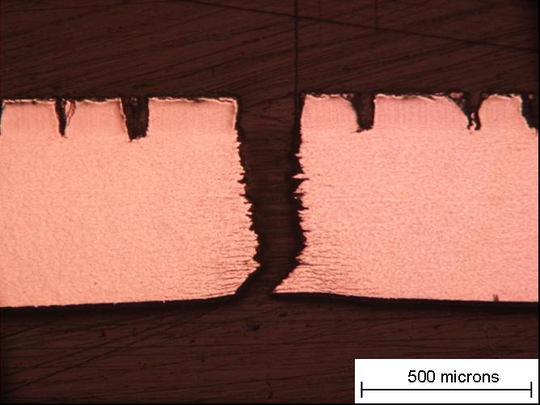
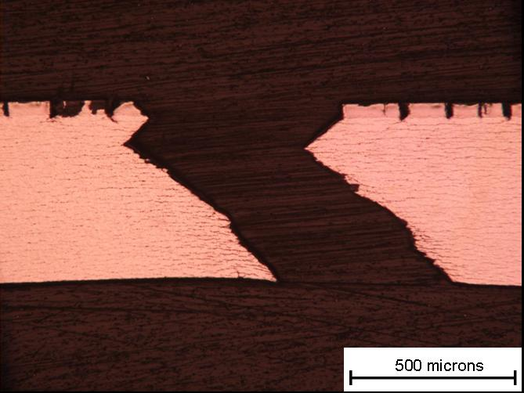
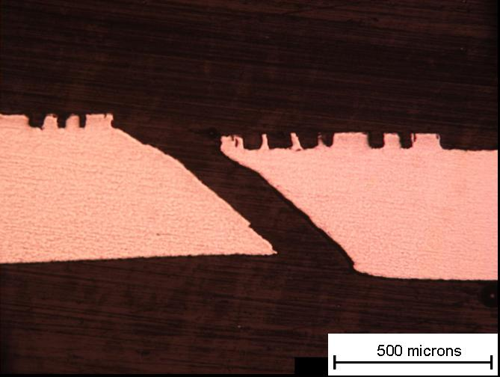
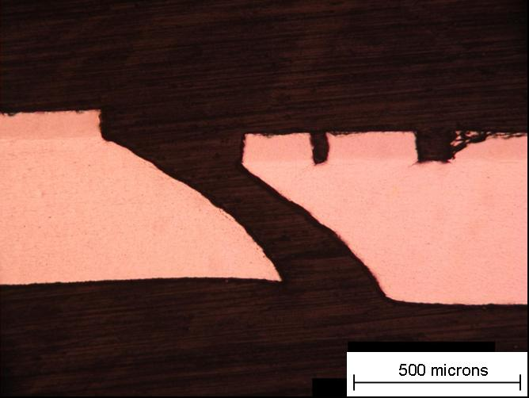
Blister failure examples
But in small blisters => shear instability
90 degree failure at RT
40 μm Blister Broken at 25 °C
M014
93 μm Blister Broken at 25 °C
M020
53 μm Blister Broken at 300 °C M025
83 μm Blister Broken at 300 °C M023
At 300 C, 45 degree shear
15

Slide 16
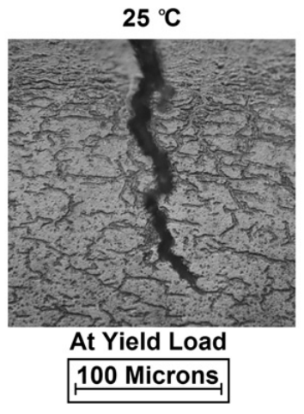
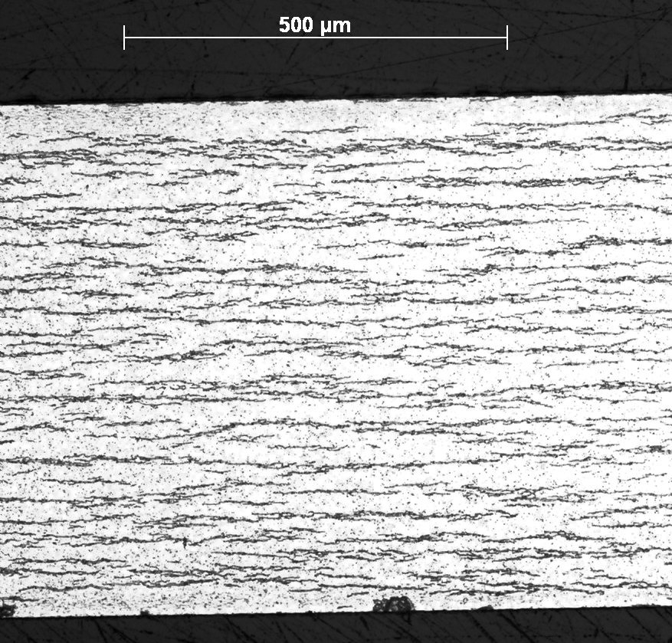
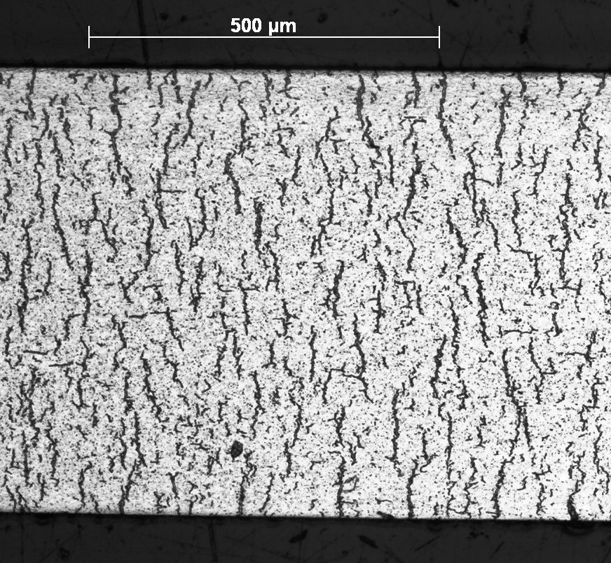
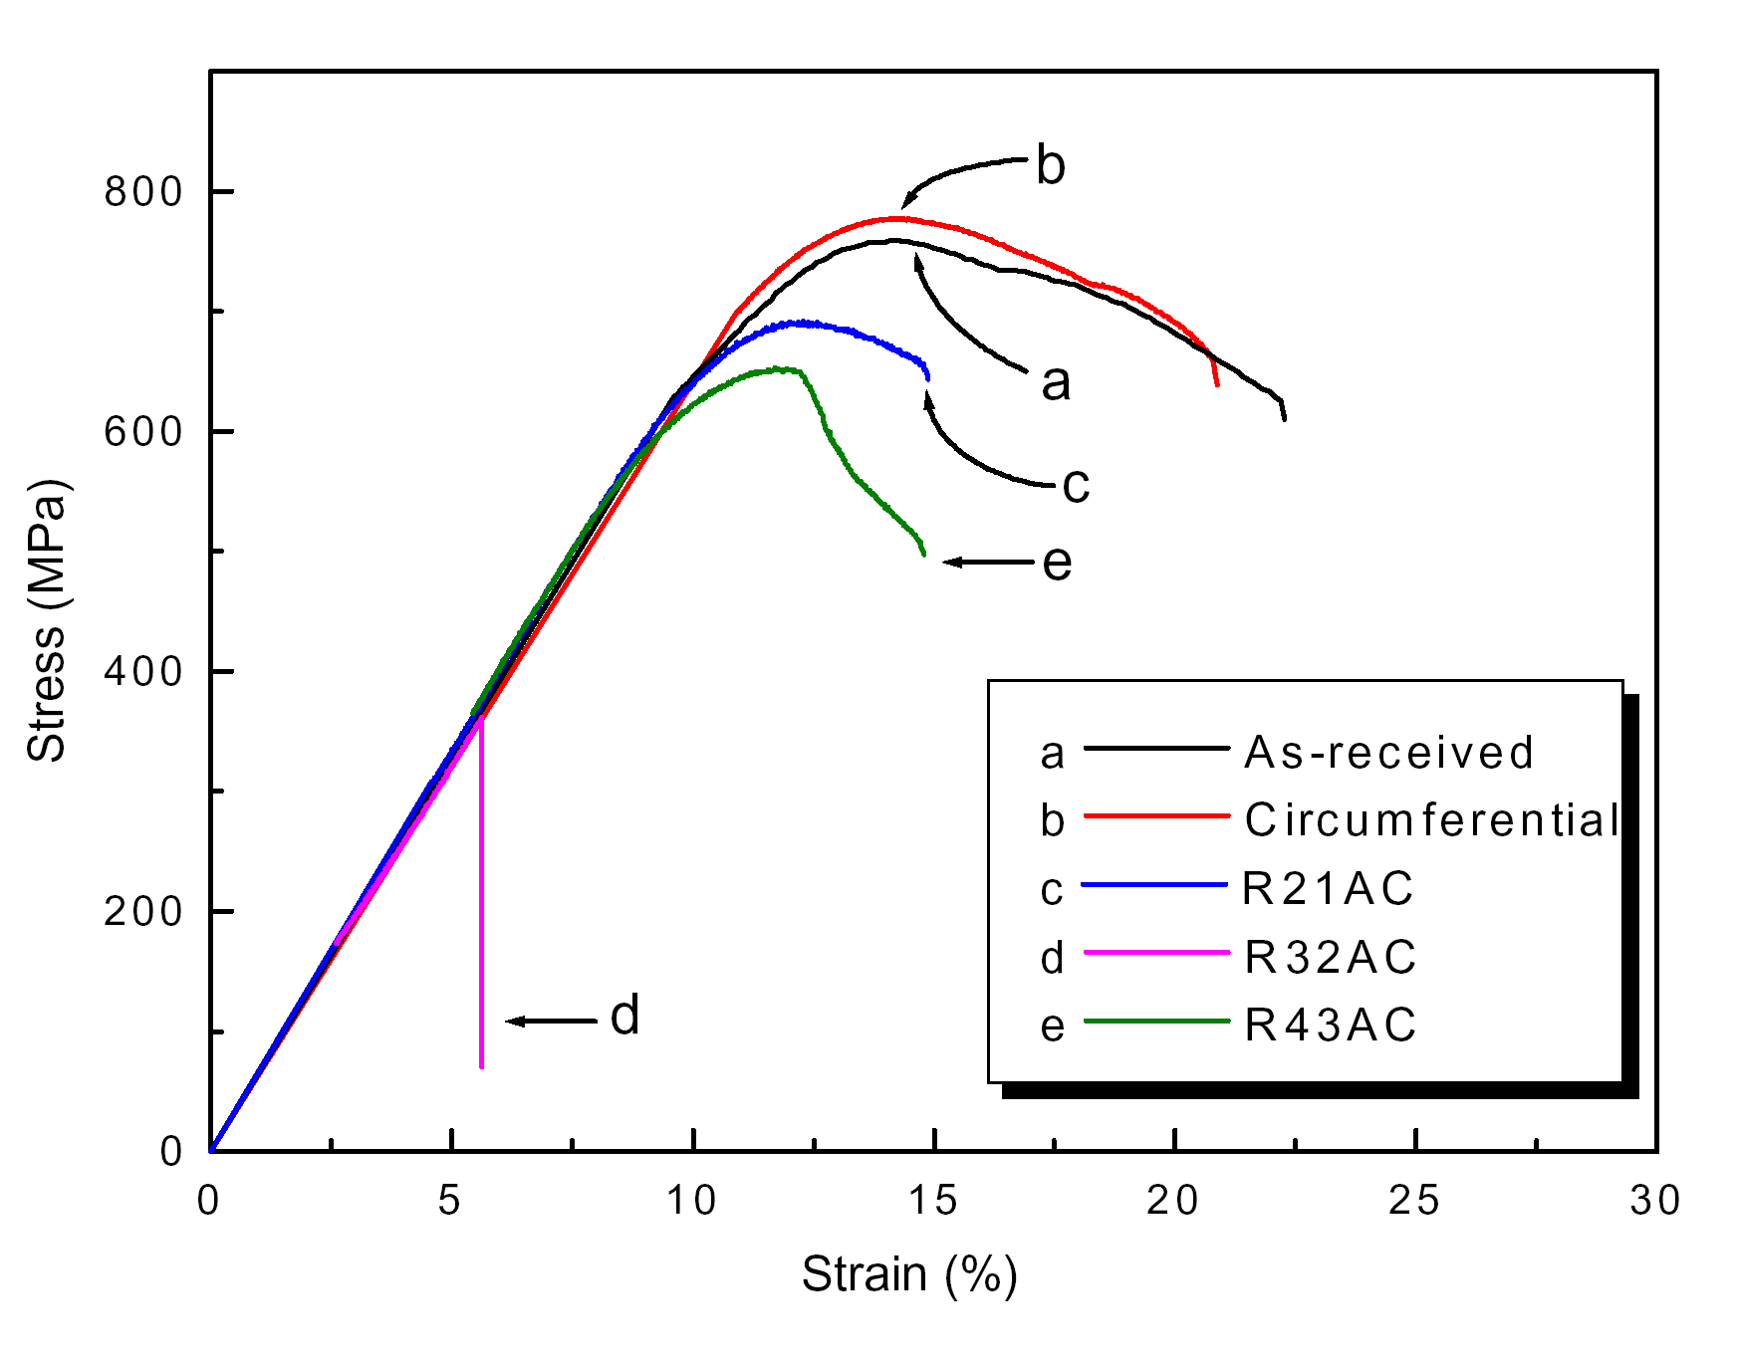
Circumferential vs Radial Hydrides
Under reactor conditions, hydride platelets precipitate circumferentially
In used fuel after drying, the hydrides can reprecipitate with a radial orientation
The hydrides reform in a radial direction due to the tensile hoop stress
Radial hydrides provide easy crack paths and significantly decrease the ductility of the cladding

Slide 17
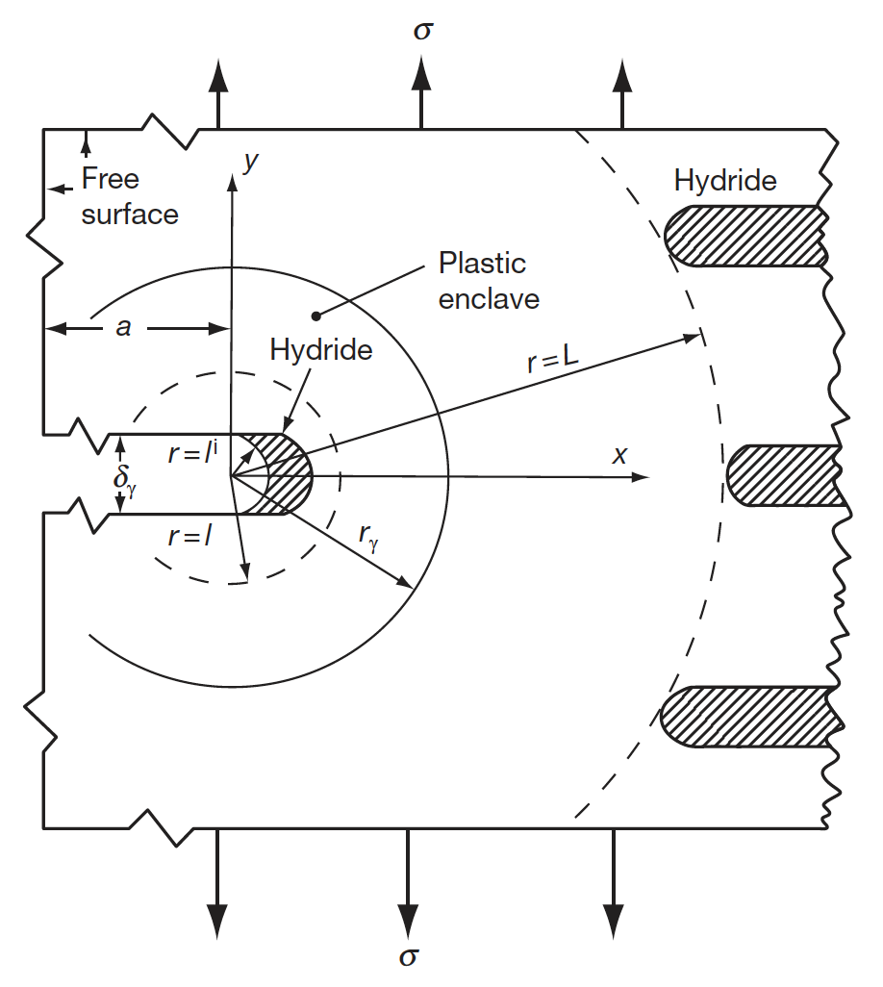
Delayed Hydride Cracking
The theory of DHS is that the crack tip hydride grows as hydrogen migrates from hydrides in the bulk of the material to the crack tip
The driving force for the diffusion of the hydrogen is the difference in the chemical potential of hydrogen between the bulk material and the crack tip hydride in response to hydrostatic stress
An increasing hydrostatic tensile stress reduces the chemical potential of hydrogen in the hydride relative to the bulk
This chemical potential difference causes hydrogen in solution to diffuse to the crack tip where it precipitates

Slide 18
Hydrides Summary
Hydrogen released by oxidation enters the cladding
It quickly diffuses throughout the cladding, but prefers low temperature
Due to low solubility (that is a function of temperature), hydrides form
Hydrides are brittle, and so reduce the ductility of the cladding
Radial hydrides can form in used fuel after drying, and reduce the ductility much more than circumferential hydrides
DHC is a phenomenon based upon increased solubility of hydrides in the high tensile stress around a crack tip

Slide 19
ACCIDENT SCENARIOS

Slide 20
Kinds of Accidents
Design basis accident: DBA
are postulated, credible accidents with low probability that are used to establish the design basis for the reactor and to define safety limits for its operation
Beyond design basis accident: BDBA
accidents that fall outside of what is designed for, because they are deemed too unlikely to be included in design

Slide 21
Reactivity Initiated Accident (RIA)
Reactivity is the fractional departure from criticality: δk = (k − 1)/k
where k is your effective multiplication factor
k = (Neutrons produced in one generation)/(Neutrons produced in the previous generation)
k = ε L_{f} p L_{th} f η – this is your six-factor formula
ε = fast fission factor
L_{f} = fast non-leakage factor
p = resonance escape probability
L_{th} = thermal non-leakage factor
f = thermal fuel utilization factor
η = reproduction factor

Slide 22
Reactivity
Reactivity = rho = r = δk = (k − 1)/k
At steady state, k=1, rho=0
Reactivity is affected by the temperature and density of coolant, moderator and fuel
Ideally, nuclear reactors are designed so that a power increase will generate negative reactivity feedback
and increase in the reactivity (higher k) leads to material changes, which in turn force a negative reactivity (lower k)

Slide 23
RIA-PWR
Design Basis Accident: Large and rapid insertion of reactivity caused by inadvertent ejection (PWR) or drop (BWR) of a control rod
A control rod ejection or drop can occur by mechanical failure of the control rod drive mechanism or its housing, and the reactivity of the core can rapidly increase due to decreasing neutron absorption
PWR
Control rod ejection accident (CREA)
Caused by mechanical failure of a control rod mechanism housing, such that the coolant pressure ejects a control rod assembly completely out of the core.
Reactivity increase to the core occurs within about 0.1 s in the worst possible scenario
The most severe CREA would occur at normal coolant temperature and pressure, but with nearly zero reactor power

Slide 24
RIA-BWR
BWR
Control rod drop accident (CRDA).
Initiated by the separation of a control rod blade from its drive mechanism.
Detached blade remains stuck in position until it suddenly becomes loose and drops out of the core in a free fall.
Most severe CRDA would occur at with the coolant close to room temperature and atmospheric pressure, and the reactor at nearly zero power
Other RIAs
inadvertent changes in coolant/moderator temperature and/or void fraction may add reactivity to the core

Slide 25
RIA
RIA leads to a fast rise in fuel power and temperature
This power ramp can lead to failure of fuel rods and release of radioactive material (or potentially fuel) into coolant
Release of hot fuel into water can cause rapid steam generation and pressure pulses, damaging other core internals
Coolant pressure pulse could break the reactor coolant pressure boundary or damage the fuel and other core internals so that long-term cooling of the core would be impaired
To prevent such consequences, safety criteria are set up to limit energy injection into the fuel

Slide 26
History of RIA
No RIA with severe consequences has occurred in PWRs or BWRs
The first reactivity-initiated accidents occurred in the 1950s and 1960s and concerned the first generation of research reactors
1952 accident in the NRX reactor at Chalk River
1961 SL-1 accident in Idaho Falls
Both resulted in severe damage and disruption of the reactor, and led to design improvements for later generations of RRs and commercial reactors
Did not eliminate RIAs
K-431 Russian Echo-II nuclear powered submarine in 1985
Chernobyl nuclear power plant, Ukraine, in 1986

Slide 27
Chernobyl RIA
Light water graphite moderated pressure tube design (RBMK)
Severe consequences of the Chernobyl accident were due to the fact that RBMKs lack not only a reactor containment, but also some of the inherent feedback mechanisms
Accident occurred under a reactor test, where normal operating guidelines were ignored and safety systems were shut off
Chernobyl accident prompted new research into reactivity initiated accidents
focused on high burnup fuel, where previous safety standards had largely been on fresh fuel or low BU

Slide 28
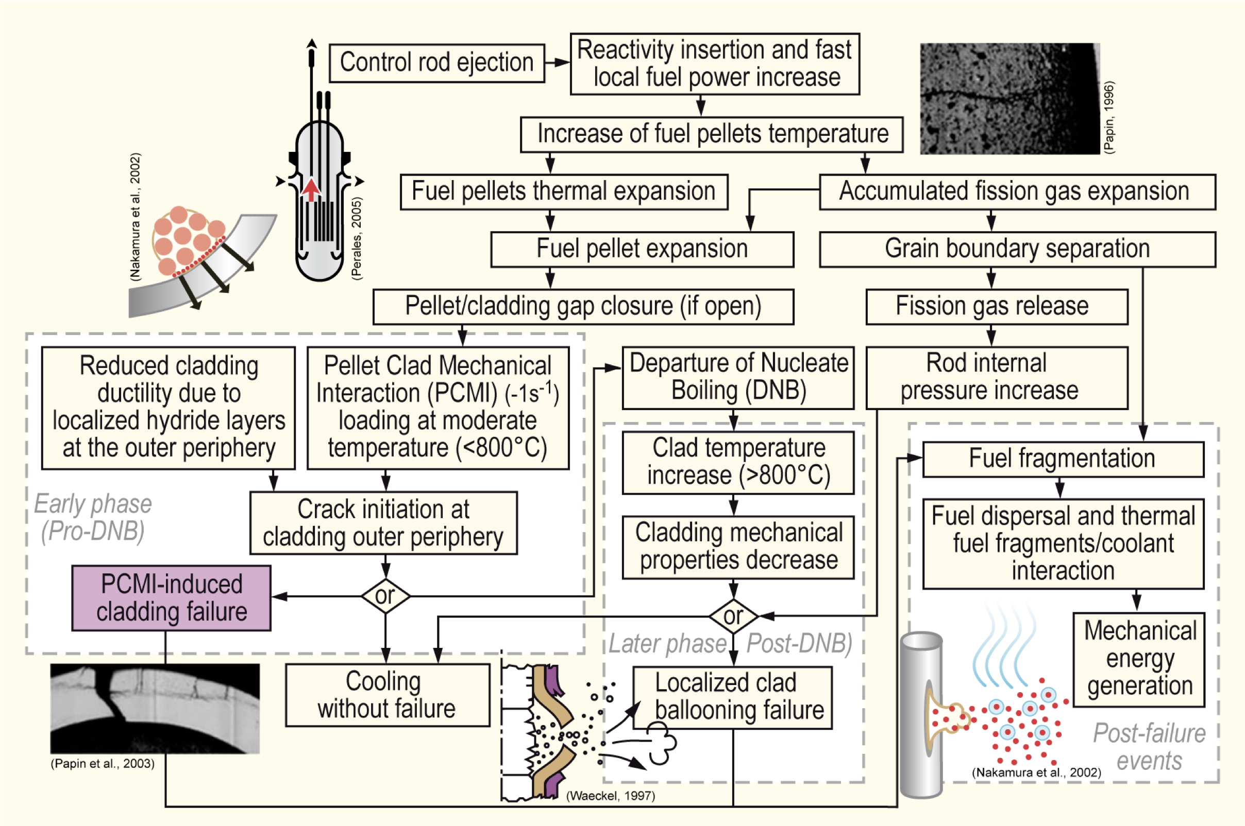
Sequence of RIA

Slide 29
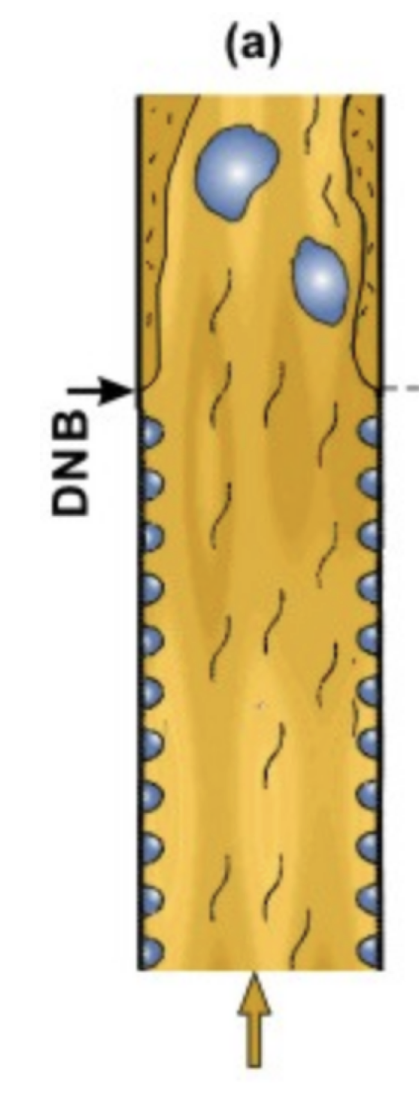
Departure from Nucleate Boiling
If the heat flux of a boiling system is higher than the critical heat flux (CHF) of the system, the bulk fluid may boil, or in some cases, regions of the bulk fluid may boil where the fluid travels in small channels
Large bubbles form, sometimes blocking the passage of the fluid
This results in a departure from nucleate boiling (DNB) in which steam bubbles no longer break away from the solid surface of the channel, bubbles dominate the channel or surface, and the heat flux dramatically decreases
Vapor essentially insulates the bulk liquid from the hot surface, increasing surface temperatures

Slide 30
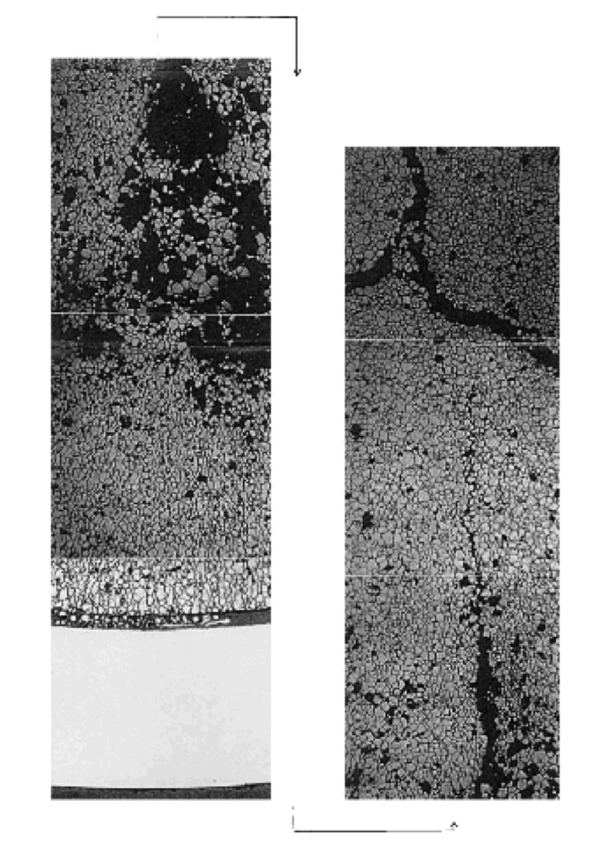
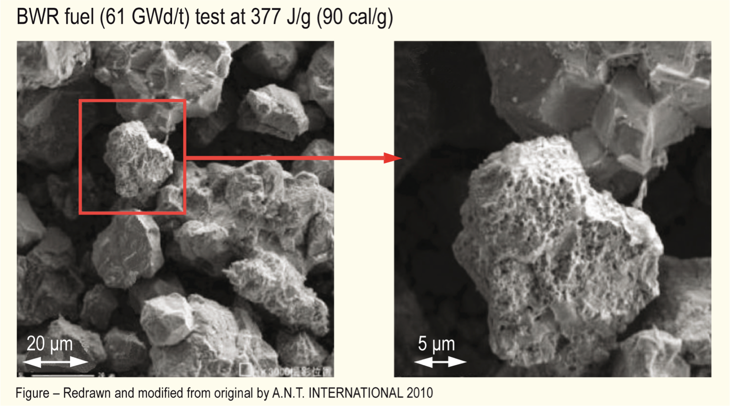
Microstructural Effects
Rapid increase in temperature increases pressure of bubbles
PV = nRT
Rapid pressure increase leads to cracking in fuel

Slide 31
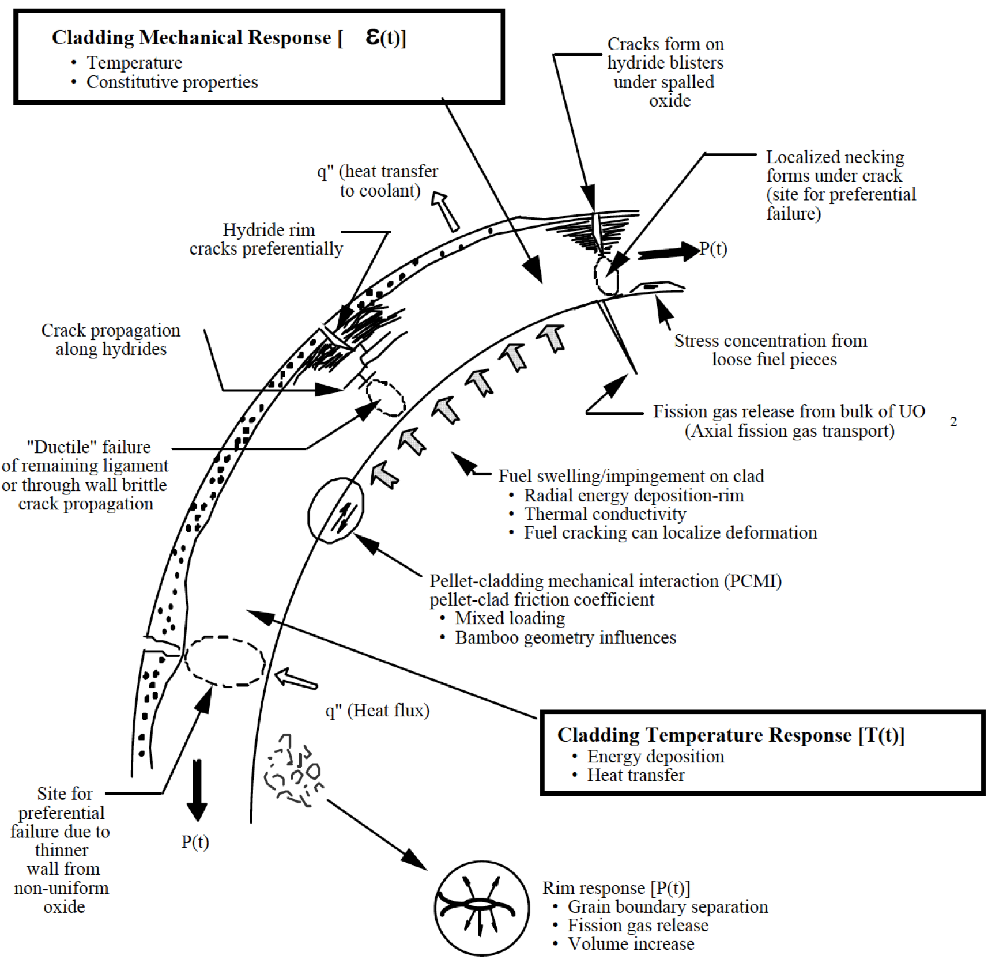
Cladding Response
Take into account burnup, corrosion (oxide layer and hydrides), damage accumulation, FCMI, internal pressure, etc. to properly evaluate strain in cladding
Temperature spike leads to a stress spike, and higher likelihood of cladding failure

Slide 32
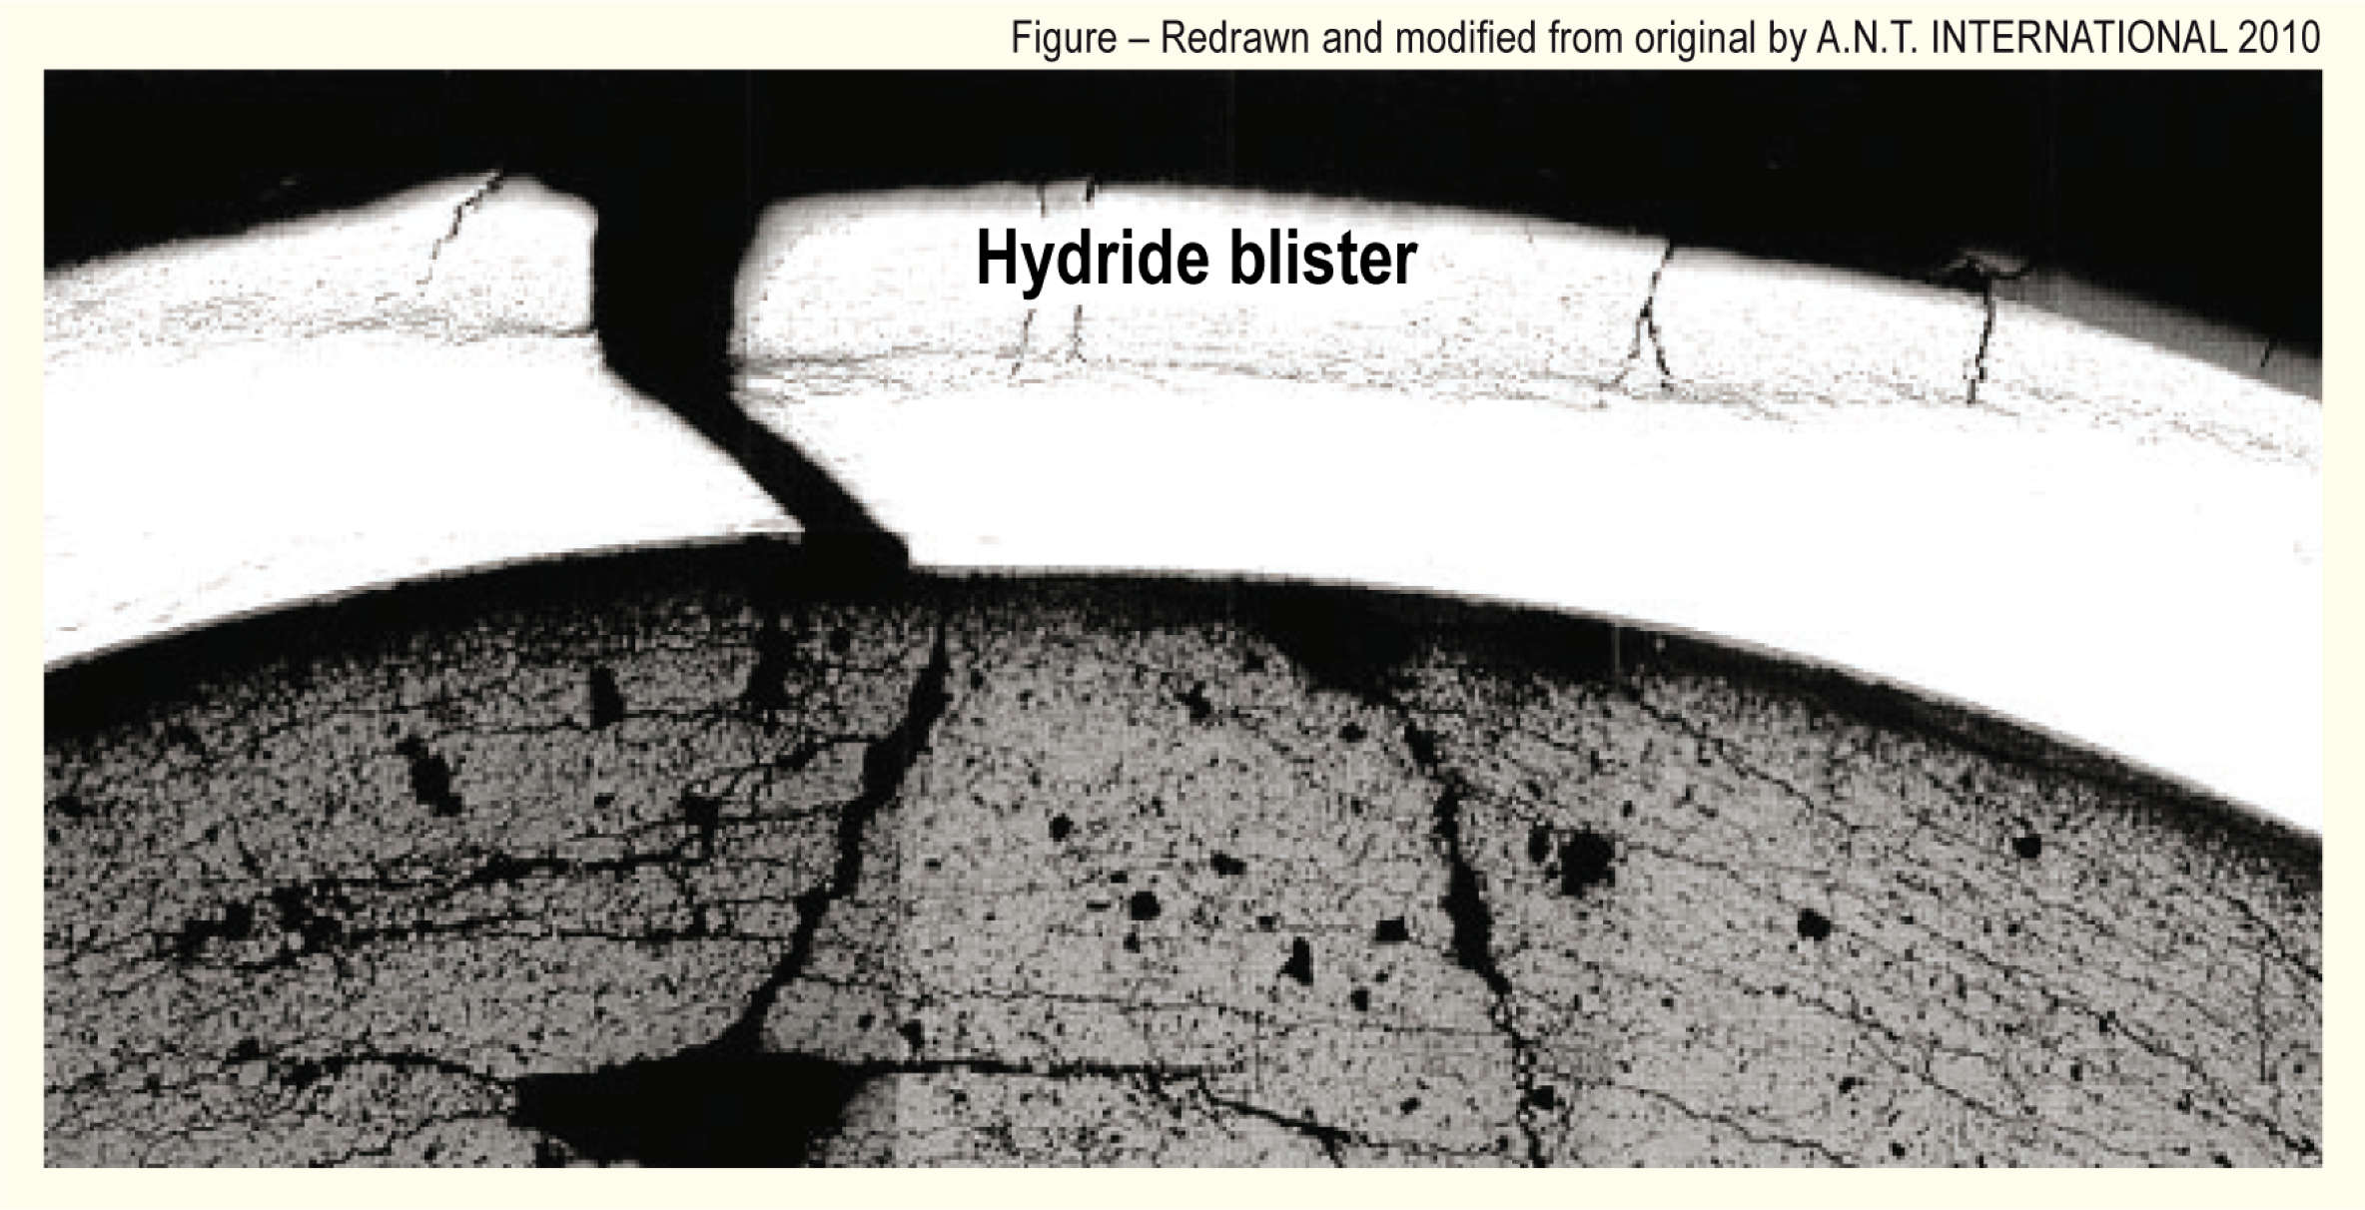
Cladding Response
PCMI failures results from the fuel pushing out on the cladding, causing it to break

Slide 33
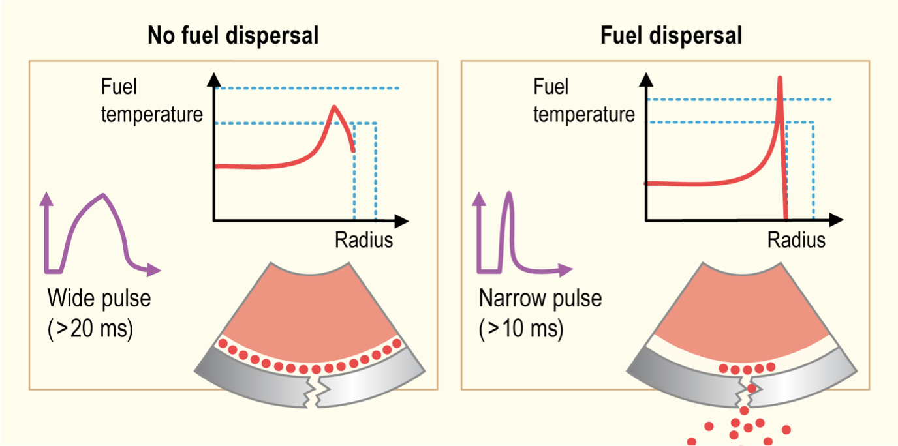
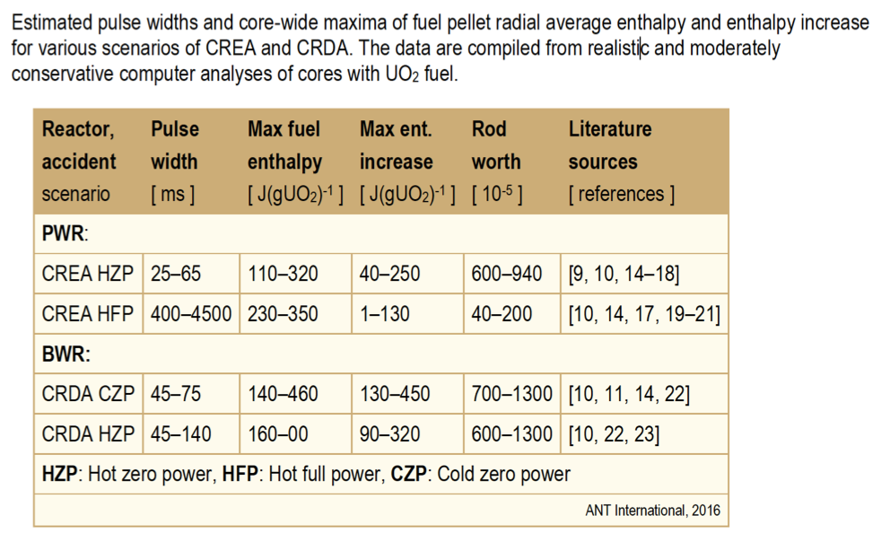
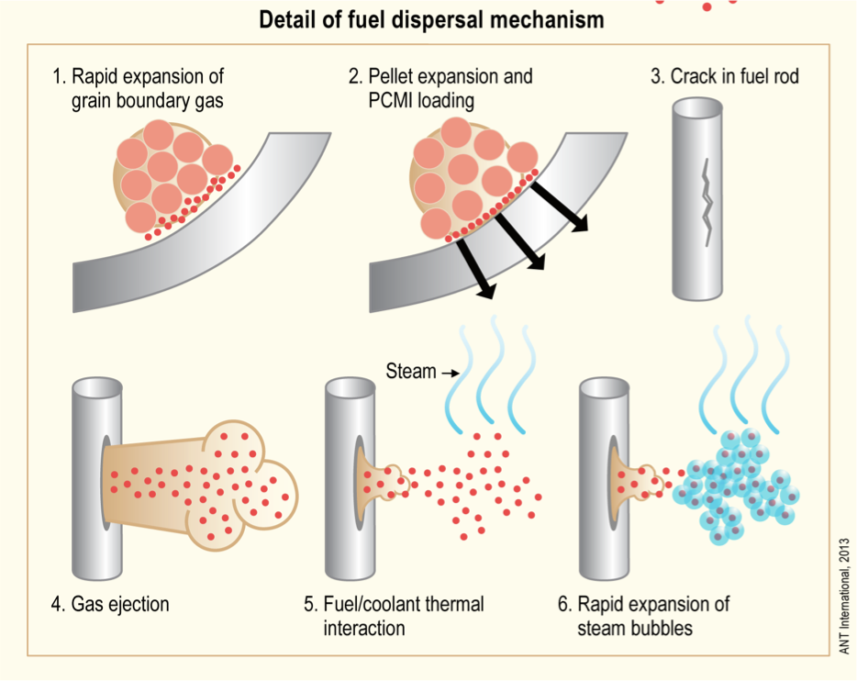
Pulse Width
The amplitude and width of the power pulse can have dramatic impacts on the effects of the RIA
Pulse is typically defined by FWHM, and by total energy deposition (integration of pulse)
More rapid temperature spike is more damaging
Reactor state and type during typical accident scenarios determine pulse width

Slide 34
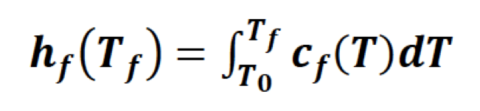
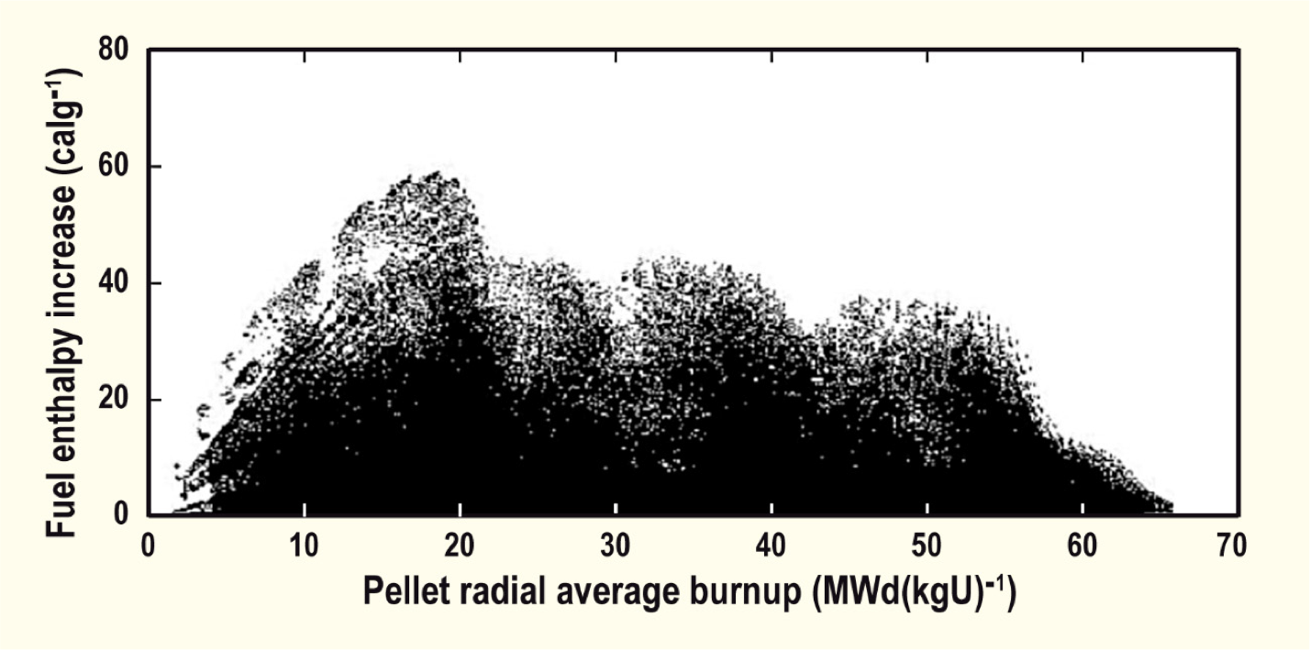
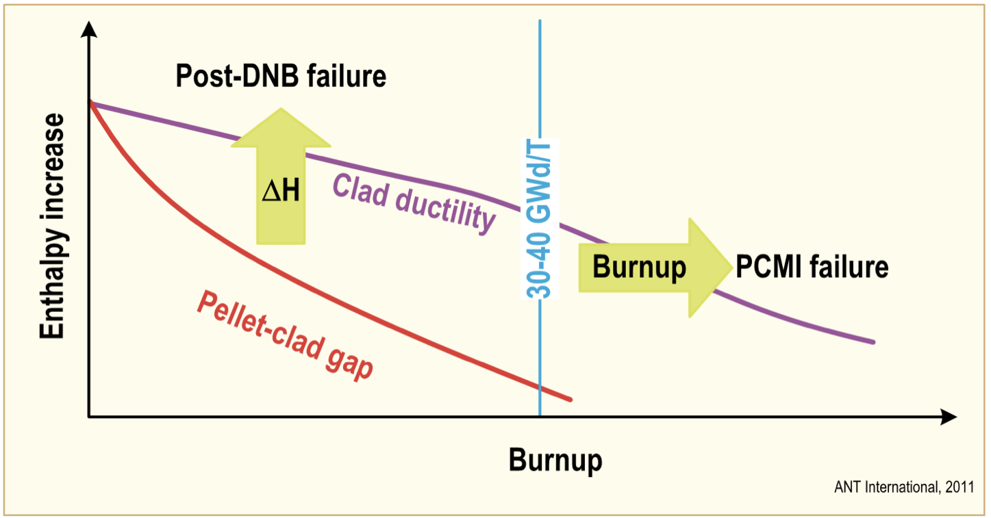
Effect of Burnup
Fuel rod damage correlates with the peak value of fuel pellet specific enthalpy; the higher the enthalpy, the more extensive is the damage
Cladding failure occurs at lower fuel enthalpies for irradiated than for fresh fuel rods, and that the susceptibility to failure increases with increasing fuel burnup
The degree of cladding waterside corrosion, is very important for survivability of preirradiated fuel rods
Safety criteria are defined in terms of limits on the radially averaged fuel pellet specific enthalpy, or the increase of this property during the accident

Slide 35
RIA Summary
Reactivity insertion accident
often in PWR/BWR dependent upon control rod ejection/drop
can be caused by changes in coolant
Shorter pulses have greater impact than longer pulses (given same energy deposition)
Effects of RIA depend on burnup
fission gas, FCMI, oxide layer, hydrides, cladding pressure, etc.

Slide 36
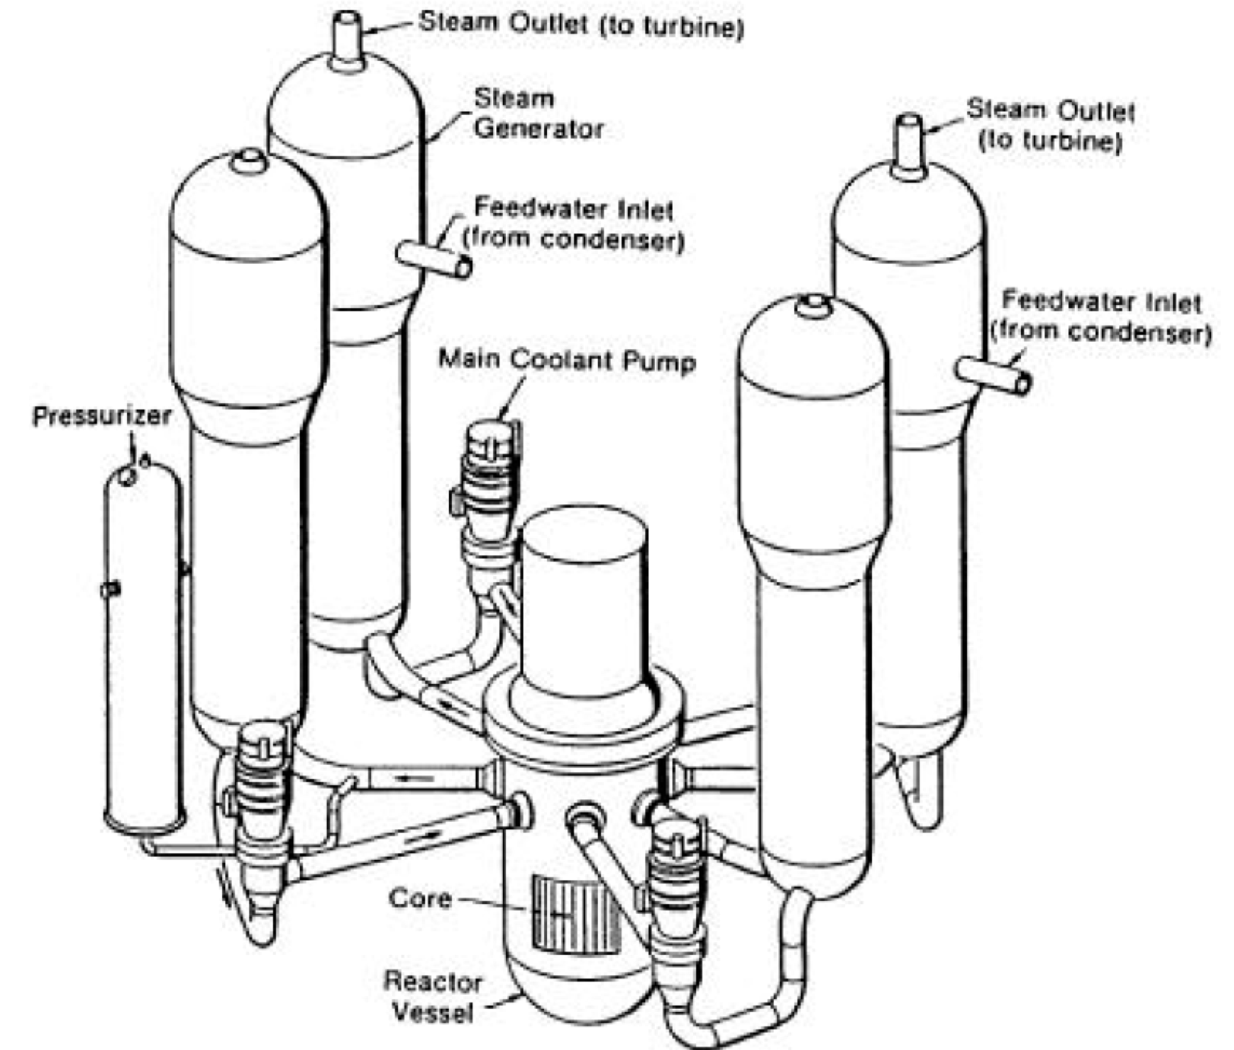
Loss of Coolant Accident (LOCA)
In a LOCA, the coolant flow is reduced or lost altogether (e.g. coolant pipe break)
When this occurs, pressure drops, causing the emergency shutdown system
SCRAMS the reactor, stopping the fission chain reaction
Also, the reactor water is expelled into the containment
The emergency core cooling system (ECCS) begins to remove heat
Requirement to maintain a coolable geometry

Slide 37
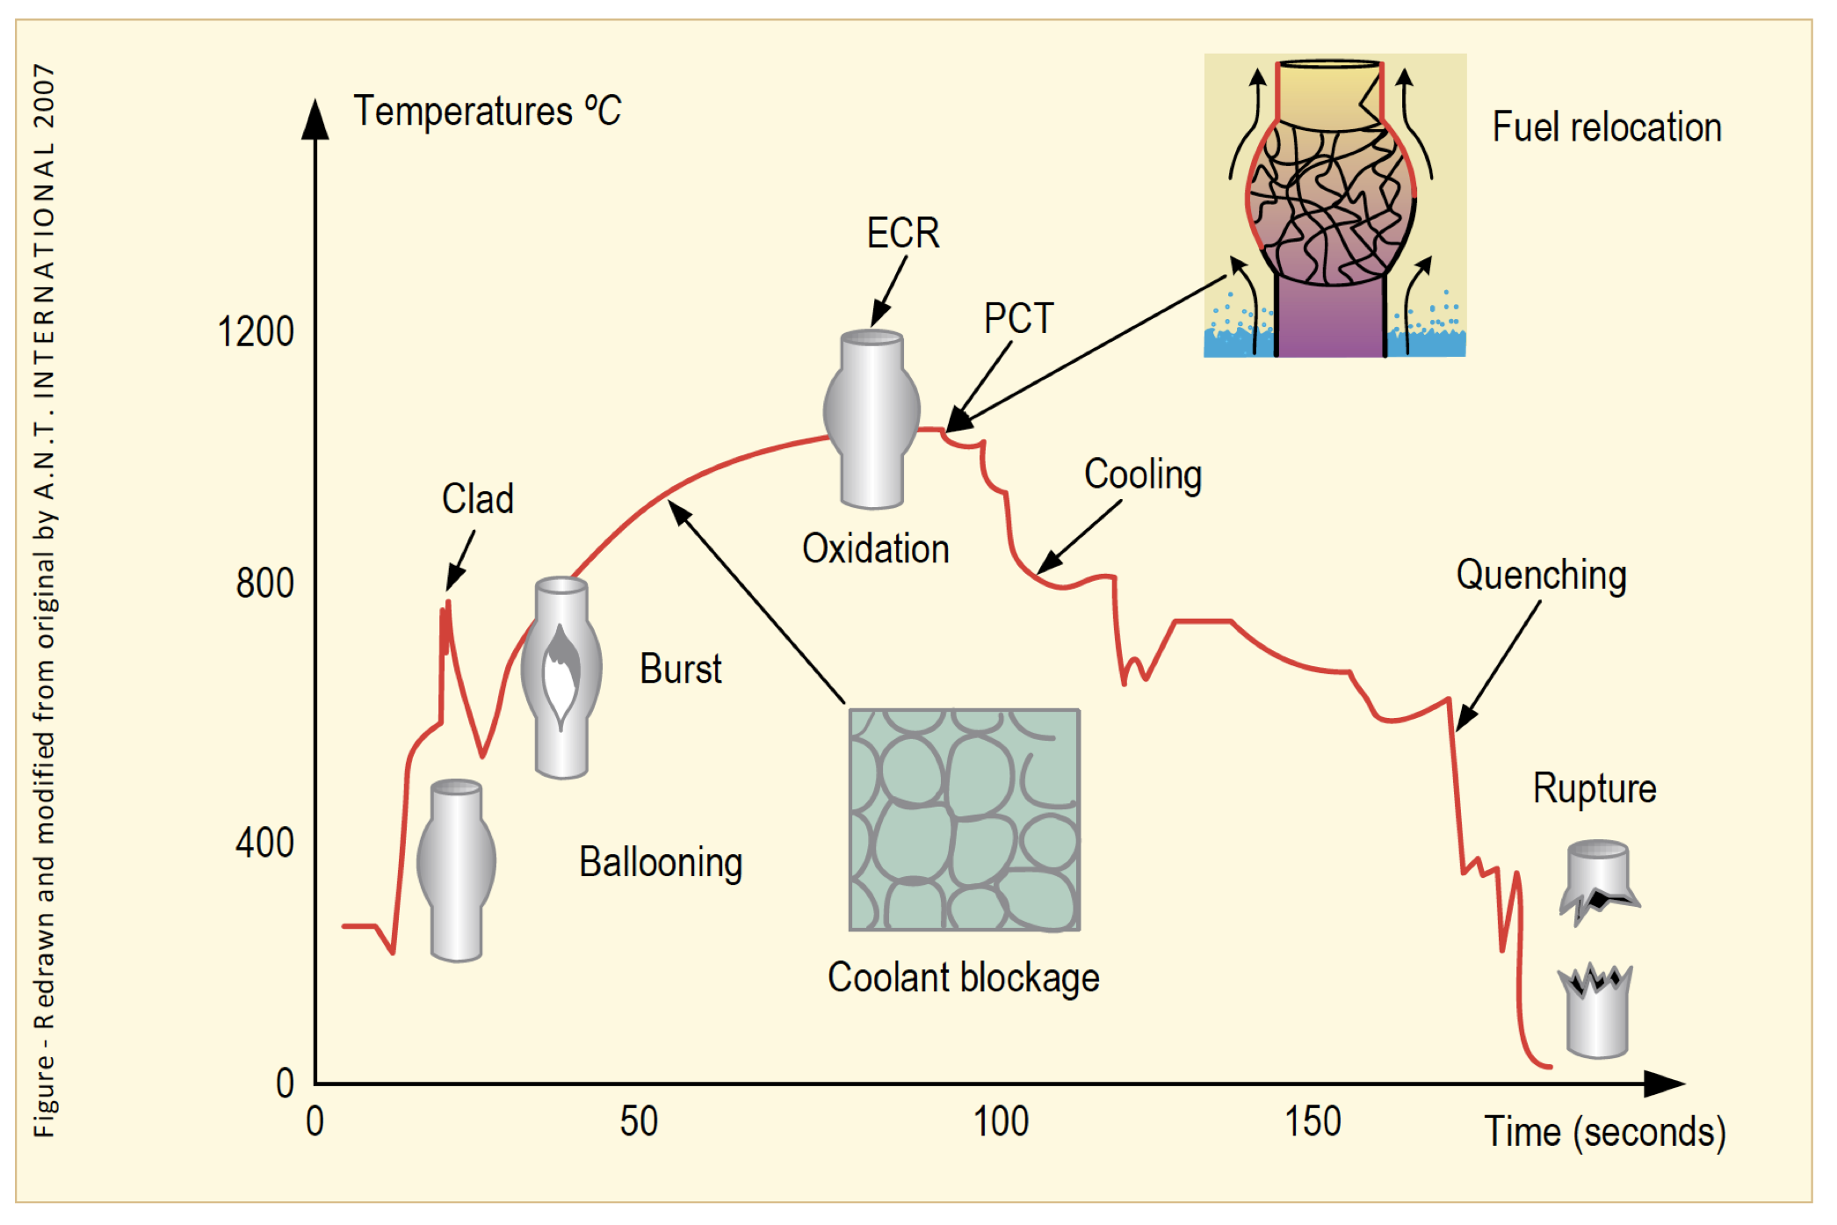
Loss of Coolant Accident (LOCA)
The average temperature of the reactor continues to rise due to radioactive decay in the fuel and the lower cooling
Decrease in coolant pressure and increase in internal pressure causes large plastic deformation
Causes the cladding to balloon out and potentially burst
Ballooning blocks coolant flow
Cladding burst is significantly impacted by oxidation and hydride embrittlement

Slide 38
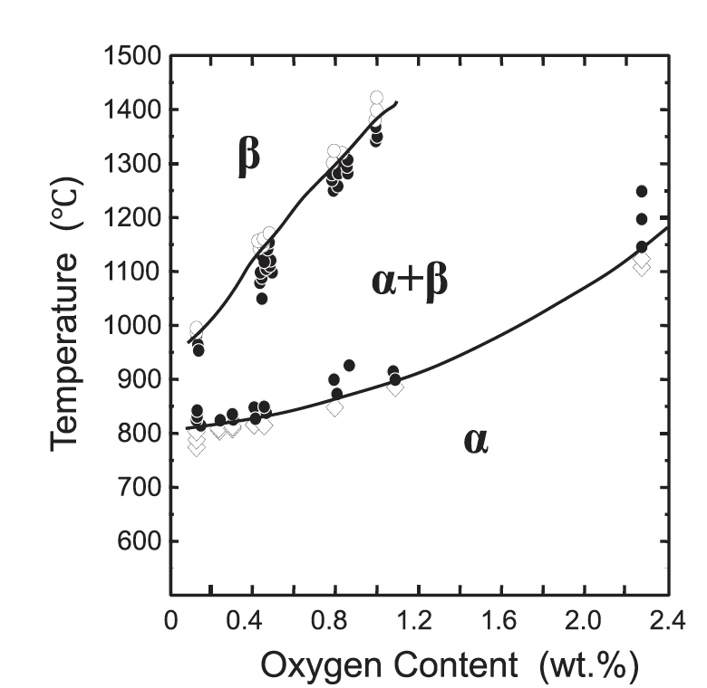
LOCA
During the heat-up, the cladding plastically deforms (balloon and rupture) due to decrease of the system pressure outside the fuel rod and decrease in cladding strength
The phase structure of Zircaloy transforms from alpha to alpha+beta above about 800C, and to beta above about 1000C
The cladding reacts with steam or coolant at high temperatures, and an oxide (ZrO2) layer is formed on the surface of the cladding
In addition, absorbed oxygen stabilizes the alpha-phase and a layer of alpha-phase with a high content of oxygen begins to grow on the beta-phase, and the beta-phase becomes less ductile by the oxygen absorption

Slide 39
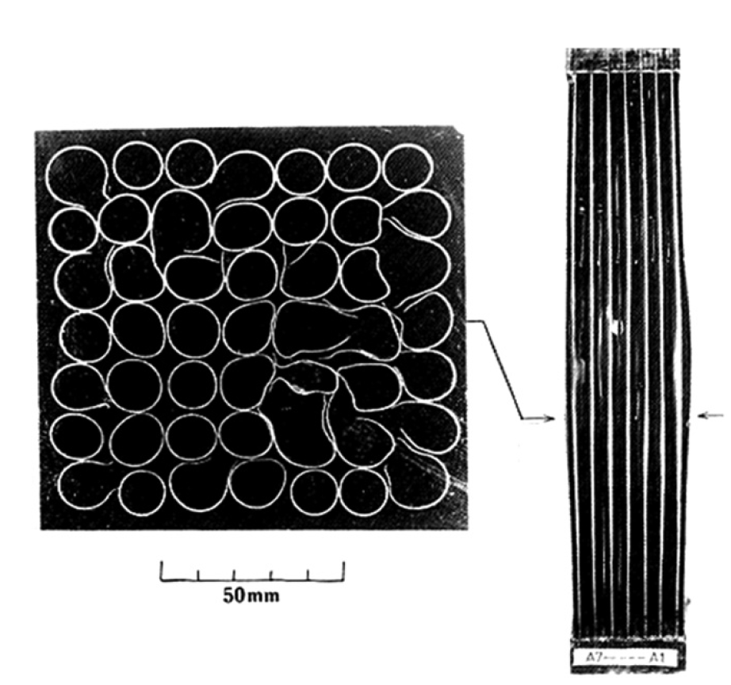
LOCA
The rod pressure becomes higher than the system pressure of the reactor due to a break of the coolant pressure boundary
Creep strength of Zircaloy rapidly falls with the temperature
The cladding plastically deforms in the radial direction (ballooning) during the heat-up and may finally rupture
The beta phase has different creep properties than the alpha phase, and alpha+beta phase can exhibit superplastic behavior
Large plastic deformation of the cladding in the radial direction results in blockage of the coolant channels between fuel rods

Slide 40
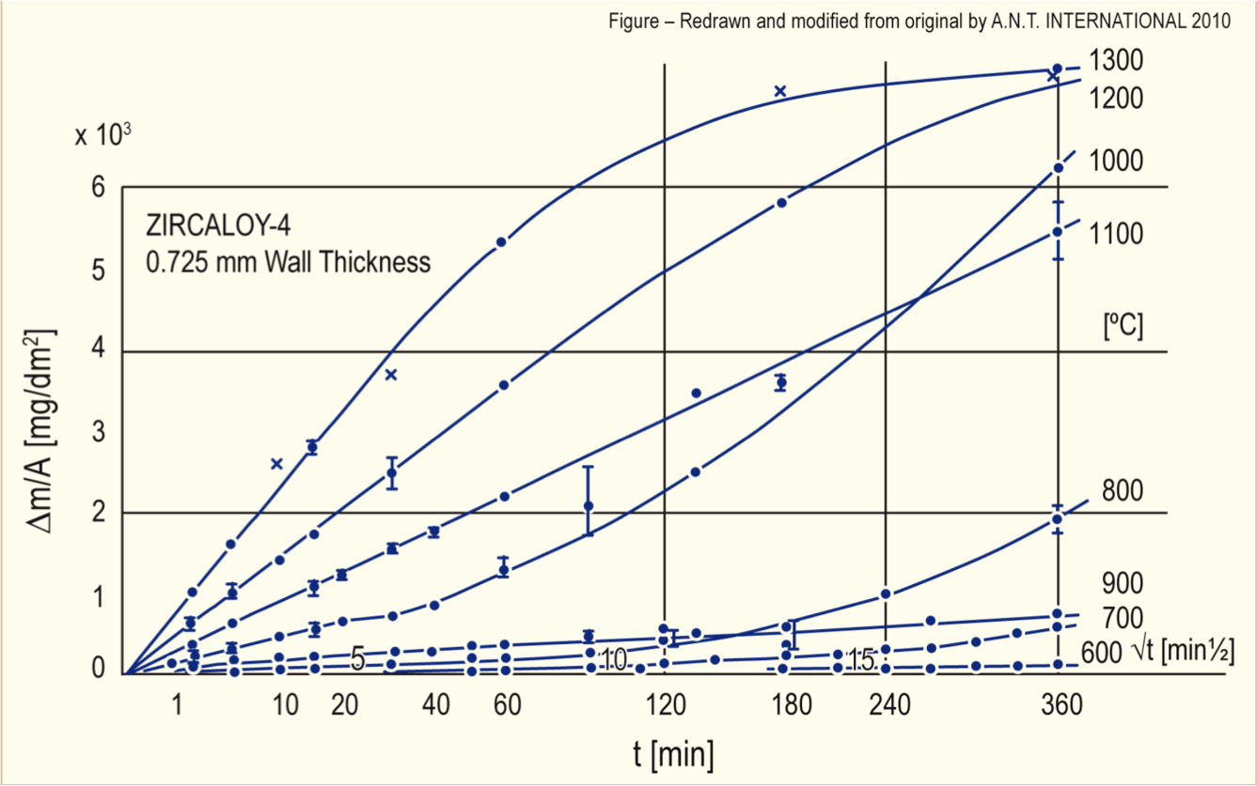
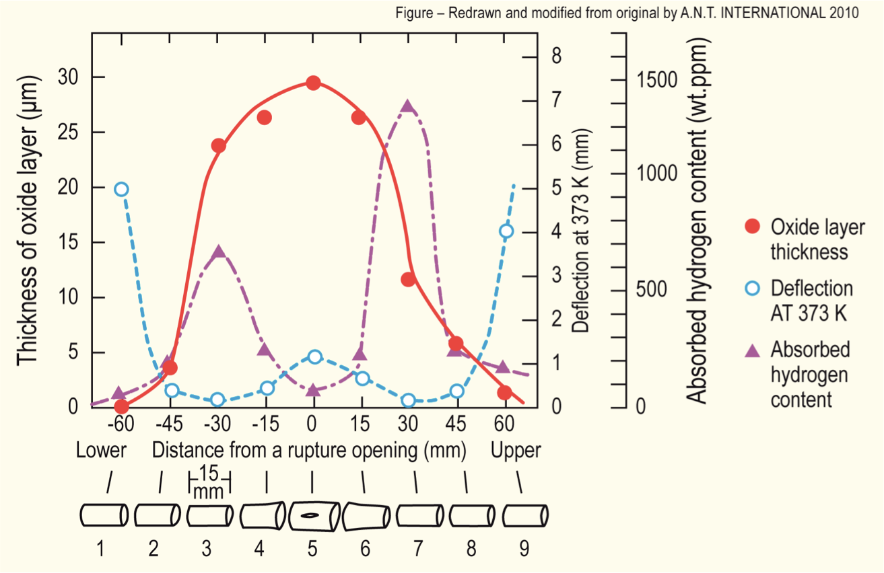
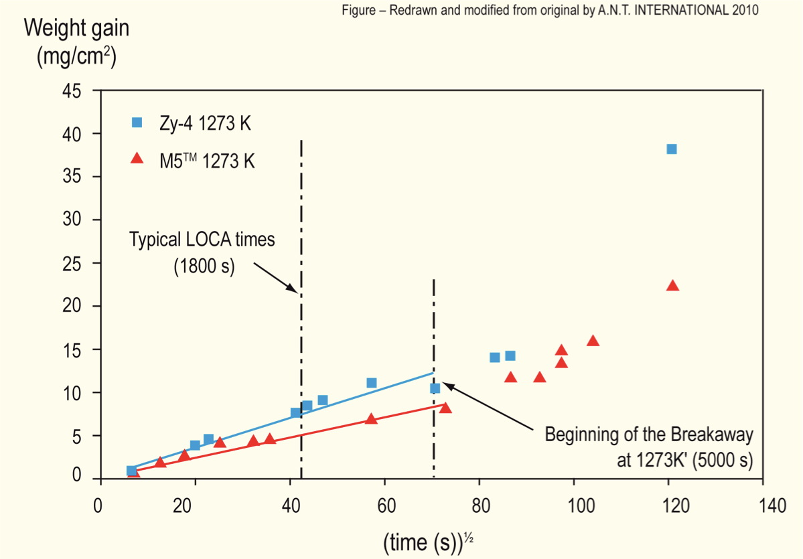
Oxidation
Oxidation significantly increases at high temperatures
Due to exothermic heat generated during oxidation of the cladding, at high enough temperatures, the rate of oxidation is so high that the heat can no longer be dissipated by cooling, leading to run-away oxidation (Three Mile Island)
Breakaway oxidation also results in increased hydrogen pickup in the cladding, embrittling cladding

Slide 41
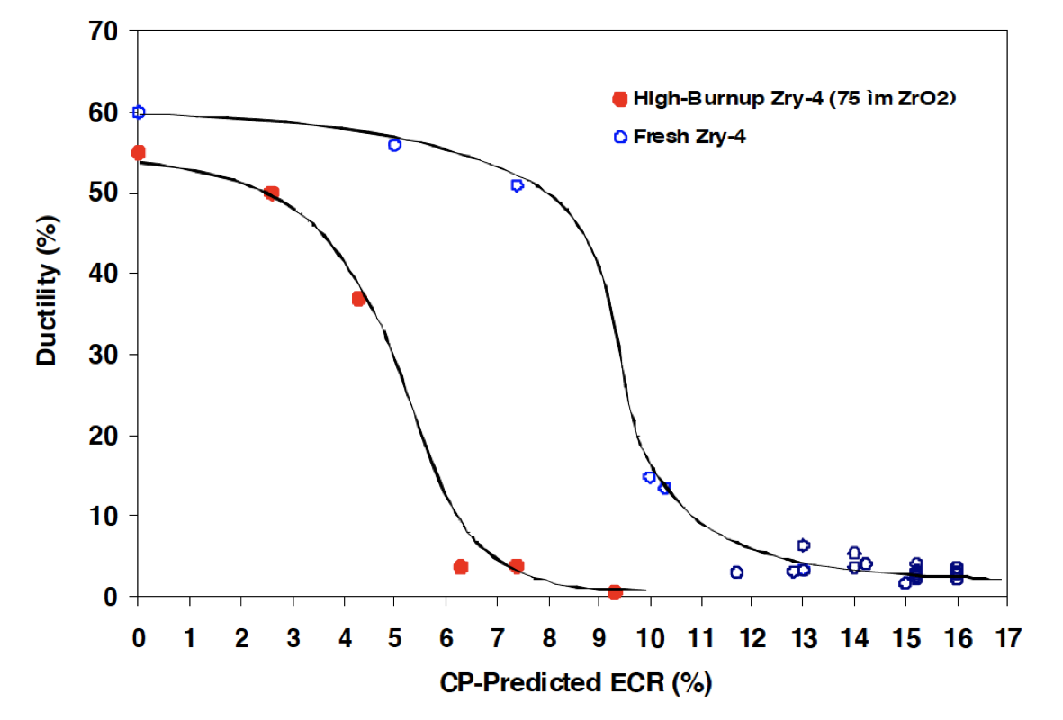
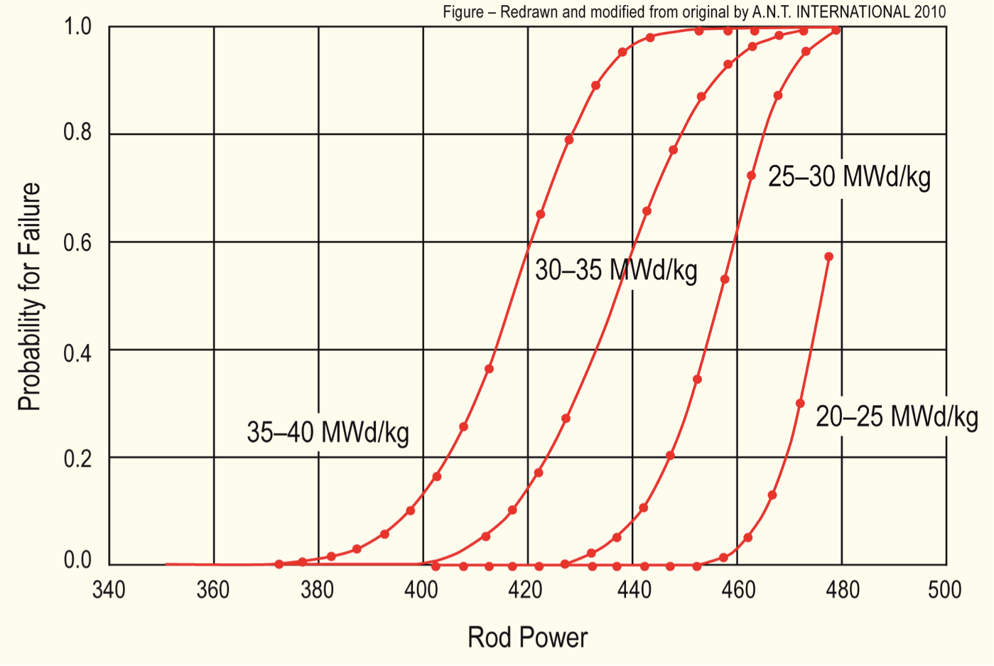
Effect of Burnup
At high burnup, ductility of the cladding is significantly reduced due to existing corrosion and hydrogen embrittlement
This leads to higher likelihood of failure for higher burnup conditions
Similar to RIA (but more slow), temperature increases can lead to gas bubble pressure increases, fuel fragmentation, increased thermal expansion, FCMI, etc.

Slide 42
Mitigation through design
Accident tolerant fuels aim to provide additional coping time
The time required for the water to boil away
The time required for the fuel to melt
The time required for the molten fuel to breach the primary pressure boundary
Fuels with enhanced tolerance can tolerate loss of active cooling for a considerably longer period, while maintaining or improving performance during normal operation

Slide 43
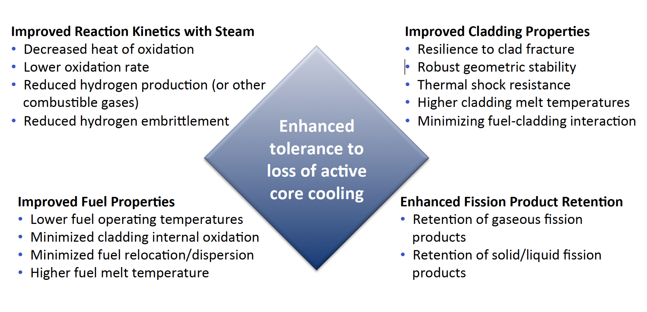
Accident Tolerance

Slide 44
ATF options being pursued
Cladding coatings/liners
protect the Zircaloy from steam: Ti3SiC2, etc.
Alternate claddings
SiC, FeCrAl, refractory alloys
UO2 dopants
Cr, SiC, BeO, etc.
Alternate fuels
USi, UN, UC, microencapsulated fuel

Slide 45
Summary
In loss of coolant accidents (LOCA), the fuel and cladding experience
increases temperature
decrease in coolant pressure
The primary negative effects are
Embrittlement and ballooning of the cladding
Relocation and fission gas release in the fuel
Cladding can burst and release fuel fragments
Accident tolerant fuel includes different fuel and cladding materials to increase time before catastrophic behavior during an accident

